Slide 1
Green IT Strategies Mix & Green IT Drivers

Slide 2
1. Green IT Strategies Mix
The table summarizes the various elements of an ERBS(Environmentally Responsible Business Strategies). These elements are grouped in four categories: Drivers, Dimension, Business, System.
Drivers—These are the motivating factors for an organization to put together a Green IT strategy and undertake transformation. Six such drivers have been identified in the Green IT strategy formulation discussed here.
Dimensions—These are the various areas along which an organization undertakes transformation. There are four such dimensions. The corporate ERBS needs to consider all four significant components of any strategy: economy, people, processes, and technologies.

Slide 3
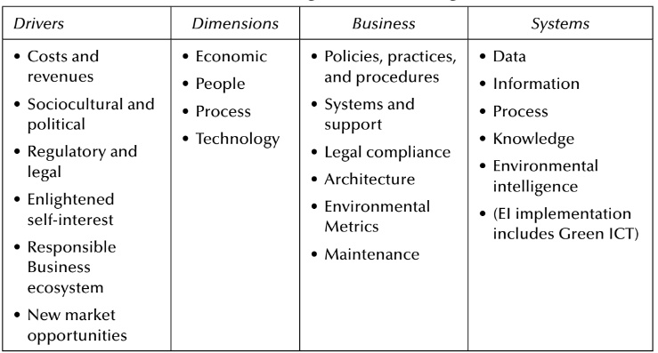
Business—This is the domain of policies, practices, and procedures undertaken by the organization along each of the four dimensions.
System—This is the systems, information technology, and contents aspect of Green IT. This is the further evolution of the concept of business intelligence into what is considered here as environmental intelligence.

Slide 4
This table also highlights the fact the Green IT strategy (also interchangeably known as an ERBS) is incorporated into and made an integral part of the overall business strategy of an organization. Since each of these elements influences the way in which the organization operates, it has specific bearings on its green credentials. -----------x------------x------------x-----------

Slide 5
2. Green IT Drivers
The drivers that impact the underlying motivations of a business for its environmental responsibility are, Figure 2.5, where six separate yet interrelated areas are seen.
Figure1 also shows a mapping between the drivers and the corresponding Green IT framework.
The strategies, policies, design, implementation, and practice of Green IT are primarily driven by one or more combination of these drivers.
These six groups of business drivers for environmental responsibility, as shown on the left in Figure 2.5 are the costs (including energy costs, operational costs); regulatory and legal; sociocultural and political; new market opportunities; enlightened self-interest; and responsible business ecosystem.
The recognition of these drivers for Green IT lead to a further investigation by Trivedi and Unhelkar (2010) who reported the results surveys relating to these drivers as presented in Figure 2.

Slide 6
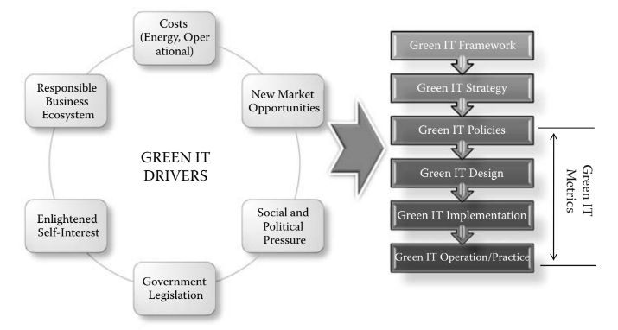
Figure 1: Drivers for environmental responsibility of business.

Slide 7
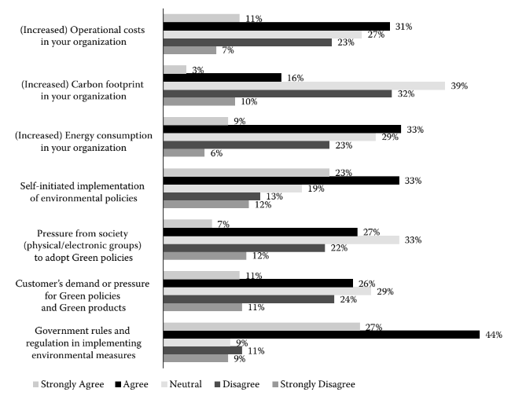
Figure 2: Drivers for carbon reduction

Slide 8
The results surveys relating to these drivers as follows:
Forty-four percent of the participants agreed and close to 27% strongly agreed on that government rules and regulation in implementing environmental measures is the major driver for carbon reduction.
Thirty-one percent of the participants agreed and close to 11% strongly agreed that operational costs by their organization is the driver for carbon reduction.
Sixteen percent of the participants agreed and close to 3% strongly agreed that carbon footprint in their organization is the driver for carbon reduction.
Thirty-three percent of the participants agreed and close to 9% strongly agreed that energy consumption by organization is the drivers for carbon reduction.

Slide 9
Thirty-three percent of the participants agreed and close to 23% strongly agreed that self-initiated implementation of environmental policies is the drivers for carbon reduction.
Twenty-seven percent of the participants agreed and close to 7% strongly agreed that pressure from society (physical/electronic groups) to adopt Green policies as the driver for carbon reduction.
Twenty-six percent of the participants agreed and close to 11% strongly agreed that customer’s demand or pressure for Green policies and Green products is the driver for carbon reduction.
About 25% disagreed-to-strongly disagreed on these as drivers for carbon reduction in their organizations.
--------------x------------------x----------------x-------------

Slide 10
THANK YOU !!!

Slide 11
1.Shweta -> Green IT Strategies Mix 2.Aamina -> Green IT Drivers 3.Khushabu -> Green IT Drivers: Surveys relating to these drivers

